Slide 1
DCM for ERP/ERF
Kaho Magami
Abiodun Olorunda
Expert: Ulrich Stoof

Slide 2
Conventional vs DCM analysis
Notes:
Functional, like correlation
Effective: has a direction, by combining anatomical connectivity
within/between column (region)

Slide 3
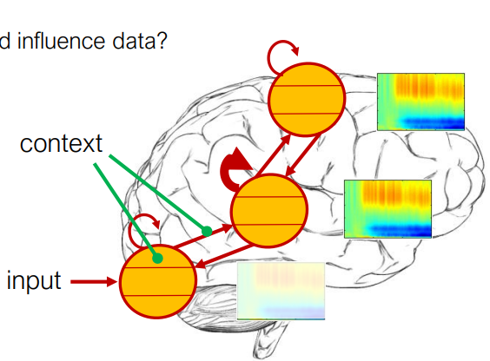
Example hypotheses to be answered by DCM
Two regions vs three regions
Top down, bottom up, or recurrent?
Which connectivity is required?
Which connection is affected by the experimental condition?
Adapted from Auksztulewicz (2022), DCM for evoked responses, Presentation, SPM for MEEG course
Notes:
Example of hypothesis

Slide 4
DCM analysis step overview
Build hypothesis + model
Model fitting
Make an inference
Collect data
Model selection
Adapted from Auksztulewicz (2022), DCM for evoked responses, Presentation, SPM for MEEG course

Slide 5
Data for DEMO
SPM Data sets :: EEG Single Subject Mismatch Negativity (ucl.ac.uk)
Notes:
MMN, different model used

Slide 6
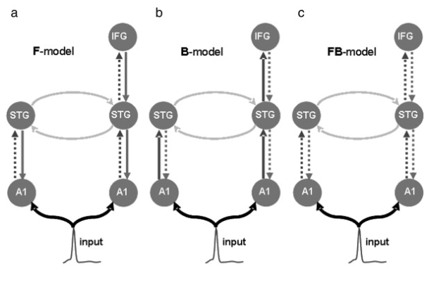
Data features: mismatch negativity
Copied from Garrido et al., (2007)

Slide 7
Step 1: Build model(s)
Build hypothesis + model
Model fitting
Make an inference
Collect data
Model selection
Adapted from Auksztulewicz (2022), DCM for evoked responses, Presentation, SPM for MEEG course

Slide 8
Potential outline
General intro (overlapping with MRI lecture, so make it brief)
What kind of research question can be answered?
How it’s answered (function + structural connectivity)
Difference with MRI
Example of the research? (MMN)
Analysis step 1: model selection - or model building
Overview: physiological vs phenomenological
Conductance vs convolution
Basic biophysical assumption of them
Briefly mention CMC as well as ERP?
(now include how to do this on SPM)
Model evaluation - or model selection + evaluation
Forward (simulation of data)
Inversion (by Bayesian)
Check the similarity with actual data and adjust if necessary
Comparison between different models
(now include how to do this on SPM)

Slide 9
MODELLING AIM AND APPROACH
MEG and EEG Data is complex-
Analysis and modelling occurs in time, frequency, time-frequency and space domains
Aims to explain all data with a few parameters
We assume data are caused by few interacting brain sources

Slide 10
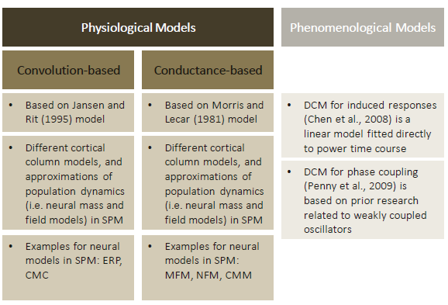
DCM Versions for EEG and MEG Data/ Analyses
More biologically detailed (e.g.
realistic parameters for neural
masses) than DCM for fMRI
Variety of models (for evoked
and induced responses, and
steady states), can be grouped
into physiological (convolution
and conductance) and
phenomenological models
- The original (convolution-based)
DCM for ERP/F (David
et al., 2006) is based on Jansen
and Rit’s (1995) neural mass
model (NMM)

Slide 11
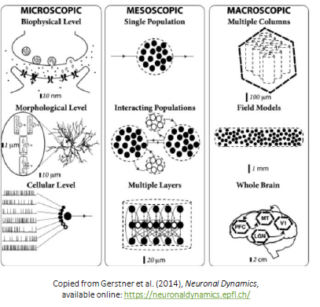
Modelling Scales and Mesoscopic Modelling
Mesoscopic modelling1
• Conceptualise the meso-scope(s) as intervening levels
• Two approaches to bridge micro- to macroscopic levels:
neuron-to-brain, or neuronal ensembles with state variables
DCM for EEG / MEEG as mesoscopic models
• Aim to derive best fitting parameter estimates (e.g. coupling) to explain the measured (observed) data (e.g. ERPs in EEG)
• Are based on neural mass models (NMM) or neural field models (NFM) which incorporate biologically plausible /experimentally derived lumped parameters
Notes:
Mesoscopic modelling1
• Conceptualise the meso-scope(s) as intervening levels
• Influenced by underlying microscopic processes
• Show also new, emergent mesoscopic dynamics
• Contribute to measurable signals (e.g. EEG, MEG)
Two approaches to bridge micro- to macroscopic levels:
neuron-to-brain, or neuronal ensembles with state variables
DCM for EEG / MEEG as mesoscopic models
• Aim to derive best fitting parameter estimates (e.g. coupling)
to explain the measured (observed) data (e.g. ERPs in EEG)
• Are based on neural mass models (NMM) or neural field
models (NFM) which incorporate biologically plausible /
experimentally derived lumped parameters
Copied from Gerstner et al. (2014), Neuronal Dynamics,
available online: https://neuronaldynamics.epfl.ch/
1 See also: Freeman (2000), Mesoscopic Brain Dynamics, and Spiegler (2012),
Dynamics of biologically informed neural mass models of the brain

Slide 12
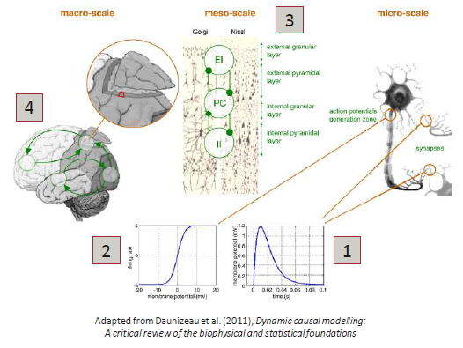
Biophysical Context of Neural Mass Models/ DCM
Neuronal features at the microscale (right)
affect dynamics at the mesoscale (cortical
column) (centre), transformation functions:
1) Linear transformation of pre-synaptic
input to post-synaptic potential (PSP)
2) Non-linear (sigmoidal) transformation of
PSP into firing rates / action potentials
Processes at the mesoscale affect dynamics at the macroscale (left), e.g.
3) Connections (strengths and directions)
between cell populations within region
4) Connections (strengths and directions)
between different (cortical) regions
Mesoscopic Neural Mass Models (NMM) aim
to capture / generate a broad range of
dynamics (e.g. measurable MEG / EEG signals)
using averages of relevant biophysical
parameters (lumped)
Notes:
Neuronal features at the microscale (right)
affect dynamics at the mesoscale (cortical
column) (centre), transformation functions:
1) Linear transformation of pre-synaptic
input to post-synaptic potential (PSP)
2) Non-linear (sigmoidal) transformation of
PSP into firing rates / action potentials
• Processes at the mesoscale affect dynamics at
the macroscale (left), e.g.
3) Connections (strengths and directions)
between cell populations within region
4) Connections (strengths and directions)
between different (cortical) regions
• Mesoscopic Neural Mass Models (NMM) aim
to capture / generate a broad range of
dynamics (e.g. measurable MEG / EEG signals)
using averages of relevant biophysical
parameters (lumped)

Slide 13
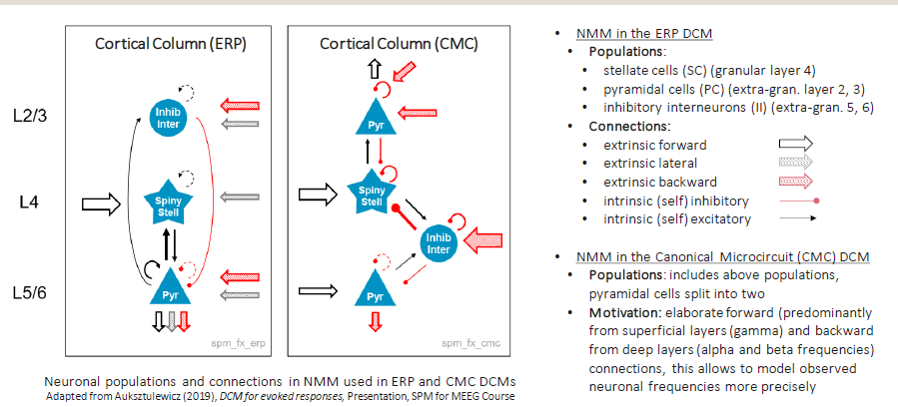
Cortical Column/ Neuronal Mass Models used in ERP and CMC DCMs

Slide 14
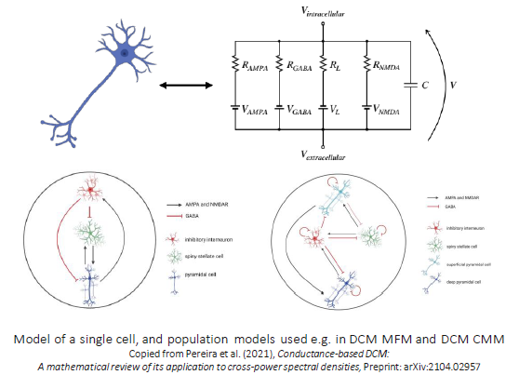
Conductance-based Models in DCM
Basics of conductance-based models
• Inspired by the Hodgkin and Huxley (1952)
single neuron model
• This approach allows to model receptors (e.g.
excitatory AMPA, NMDA, inhibitory GABA)
expressed in neurons / populations
• Different conductance-based DCMs allow to
model with various receptor types (in steady state
or perturbation experiments)
From neurons to populations to sources
• As in convolution based models, neurons are
grouped into populations, and further into
cortical columns
• Different cortical column models are defined,
e.g. with three / four different populations
• Dynamics (statistics) of cortical columns can
are captured with neural mass (NMM), mean
field (MFM), and neural field models (NFM)
Notes:
Basics of conductance-based models
• Inspired by the Hodgkin and Huxley (1952)
single neuron model, which models the states
of cells based on the ion-flow in / out of a cell
• This approach allows to model receptors (e.g.
excitatory AMPA, NMDA, inhibitory GABA)
expressed in neurons / populations
• Different conductance-based DCMs allow to
model with various receptor types (in steadystate
or perturbation experiments)
• From neurons to populations to sources
• As in convolution based models, neurons are
grouped into populations, and further into
cortical columns
• Different cortical column models are defined,
e.g. with three / four different populations
• Dynamics (statistics) of cortical columns can
are captured with neural mass (NMM), mean
field (MFM), and neural field models (NFM)

Slide 15
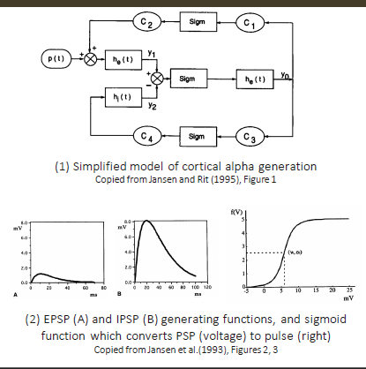
Features of Jansen and Rit Model (1995)
Aim: to replicate evoked potentials in the visual cortex
Single-column model (1):
• Populations: abstract cortical column with three populations
(pyramidal cells, excitatory and inhibitory local interneurons)
• Connections: pyramidal cells receive local input as well as
excitatory input from distant / other cortical columns (p(t))
• Transformations: i) linear (he(t), hi(t)) converting input into PSP, ii) a non-linear (sigmoidal) (Sigm) converting PSP into firing rates
• Parameters: e.g. experimentally derived connectivity constants
(C1-C4) (number of synapses, lumped into C), maximal amplitudes
for IPSP and EPSP (A, B), e0 maximum firing rate of the population,
v0 the PSP for which 50% firing rate is achieved
• Model exploration and behaviour: particularly explored four dimensional parameter space (A,B,C,v0), showed that alpha and
beta activity can be replicated with different parameter choices
Double-column model (not shown here):
• Extension: combined two cortical columns of structure (1)
• Additional parameters: K (connectivity constants), ad (delay)
• Model exploration and behaviour: i) with identical columns:
produced in-phase oscillations; ii) with different columns:
produced alpha and beta oscillations
Notes:
Single-column model (1):
• Populations: abstract cortical column with three populations
(pyramidal cells, excitatory and inhibitory local interneurons)
• Connections: pyramidal cells receive local input as well as
excitatory input from distant / other cortical columns (p(t))
• Transformations: i) linear (he(t), hi(t)) converting input into PSP, ii) a
non-linear (sigmoidal) (Sigm) converting PSP into firing rates
• Parameters: e.g. experimentally derived connectivity constants
(C1-C4) (number of synapses, lumped into C), maximal amplitudes
for IPSP and EPSP (A, B), e0 maximum firing rate of the population,
v0 the PSP for which 50% firing rate is achieved
• Model exploration and behaviour: particularly explored fourdimensional
parameter space (A,B,C,v0), showed that alpha and
beta activity can be replicated with different parameter choices
• Double-column model (not shown here):
• Extension: combined two cortical columns of structure (1)
• Additional parameters: K (connectivity constants), ad (delay)
• Model exploration and behaviour: i) with identical columns:
produced in-phase oscillations; ii) with different columns:
produced alpha and beta oscillations

Slide 16
Step 2: Model fitting
Build hypothesis + model
Model fitting
Make an inference
Collect data
Model selection
Adapted from Auksztulewicz (2022), DCM for evoked responses, Presentation, SPM for MEEG course

Slide 17
Recap: generative model
Copied from van Wijk (2022), ,The principles of dynamic causal modeling, Presentation, SPM for MEEG course
Notes:
Generative model is a combination of NMM and source dynamics

Slide 18
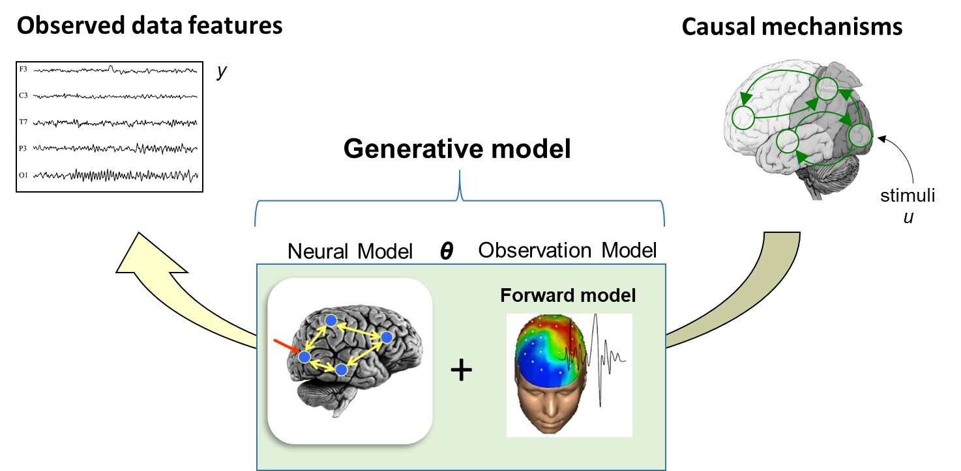
Next step: simulation
Copied from van Wijk (2022), ,The principles of dynamic causal modeling, Presentation, SPM for MEEG course

Slide 19
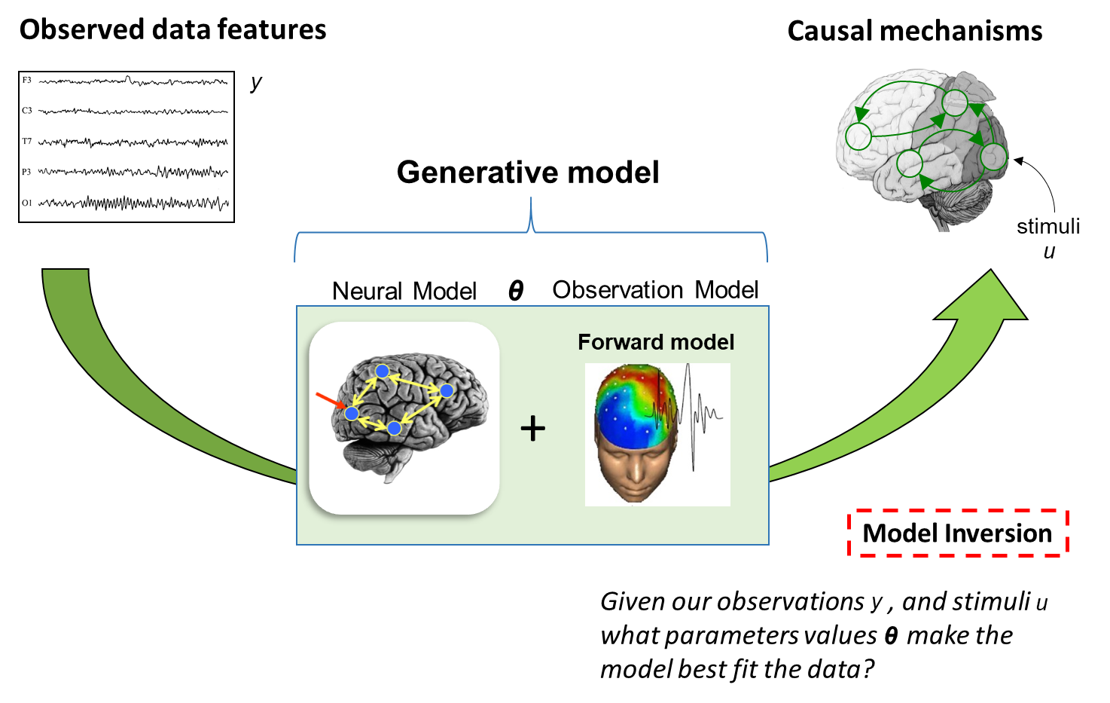
Next step: model inversion (fitting)
This allows for model selection and parameter inference (next section)
Copied from van Wijk (2022), ,The principles of dynamic causal modeling, Presentation, SPM for MEEG course

Slide 20
Model inversion with Bayesian inference
Used for model selection/result interpretation
Copied from van Wijk (2022), ,The principles of dynamic causal modeling, Presentation, SPM for MEEG course
Notes:
As this is Bayesian, prior is required: mostly biophysically grounded
estimate the most likely parameter values that could have generated the observed data features
Continues until variational free energy is minimum as

Slide 21
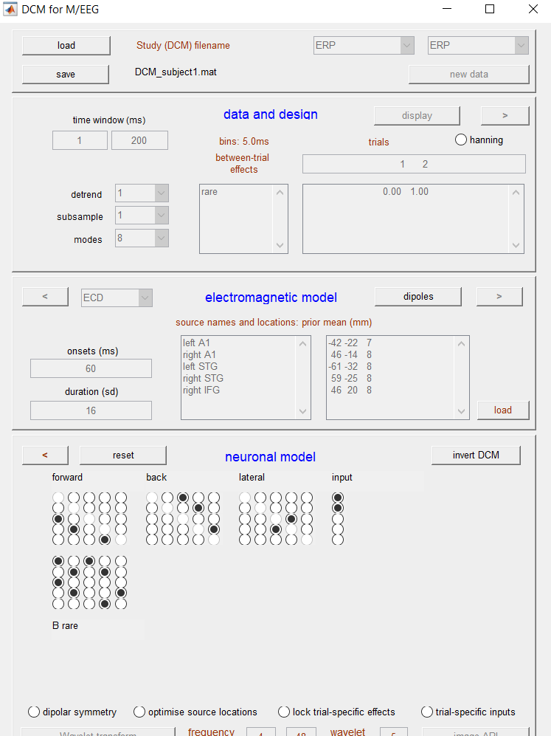
Demo: model inversion

Slide 22
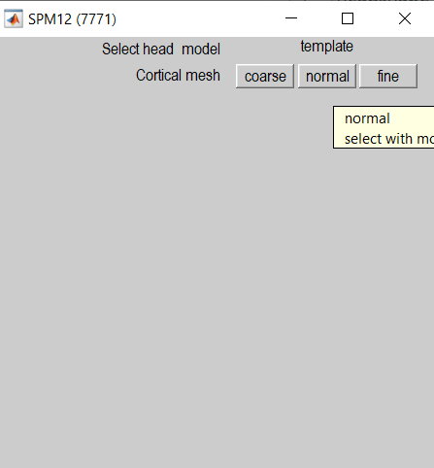
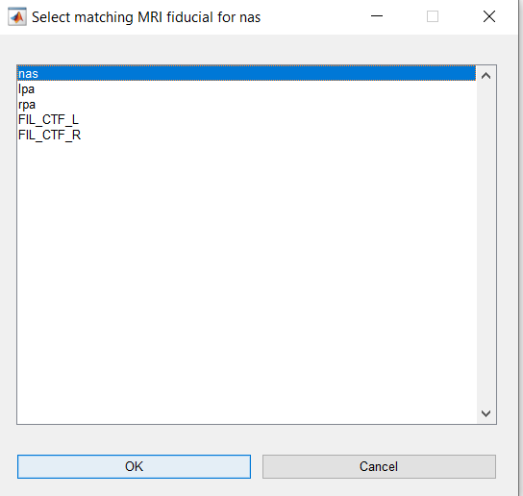
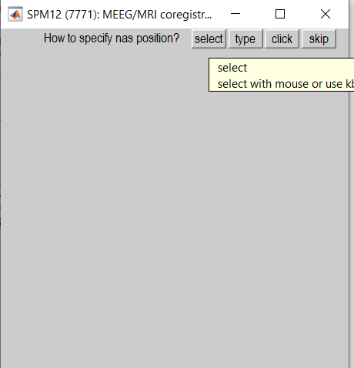
Demo: head model calculation
Template -> normal
nasion/LPA/RPA: select
-> select the matching name
Only if you haven’t done source reconstruction before

Slide 23
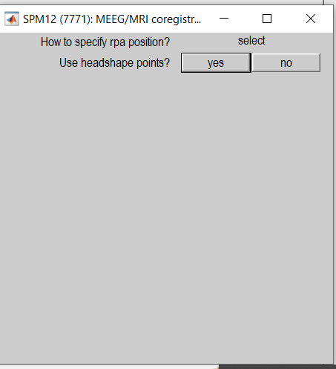
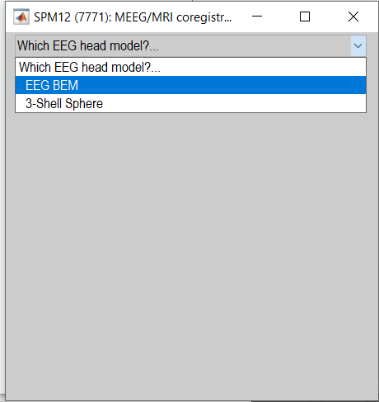
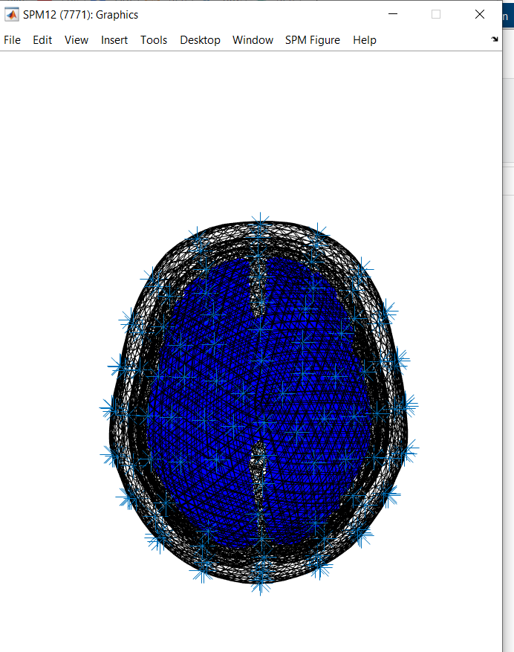
Demo: head model calculation
Headshape -> yes
Head model: BEM
Lead field is calculated

Slide 24
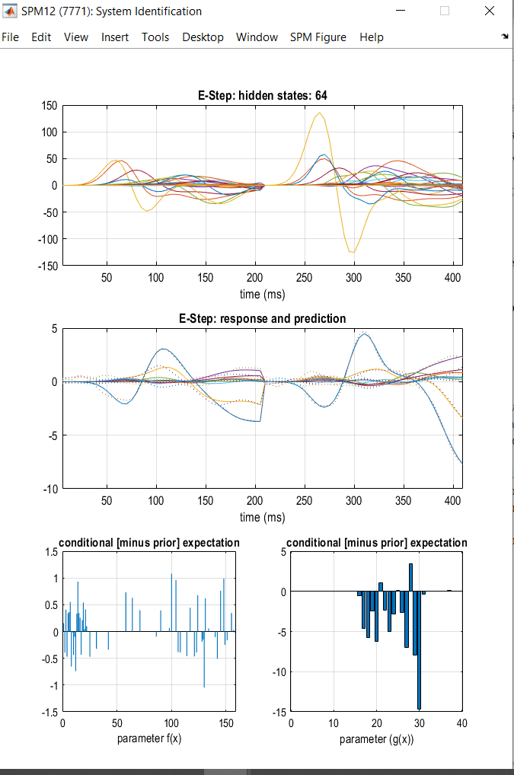
During inversion
Num of iteration
estimated source activity for different neuronal sources and populations (separate lines) and experimental conditions (left and right)

Slide 25
During inversion
observed (dashed lines) and model-predicted (solid lines) responses for all experimental conditions (separate subplots), with different colours representing different spatiotemporal modes

Slide 26
During inversion
updates in parameter space (left: neuronal parameters of the model; right: spatial parameters of the model)

Slide 27
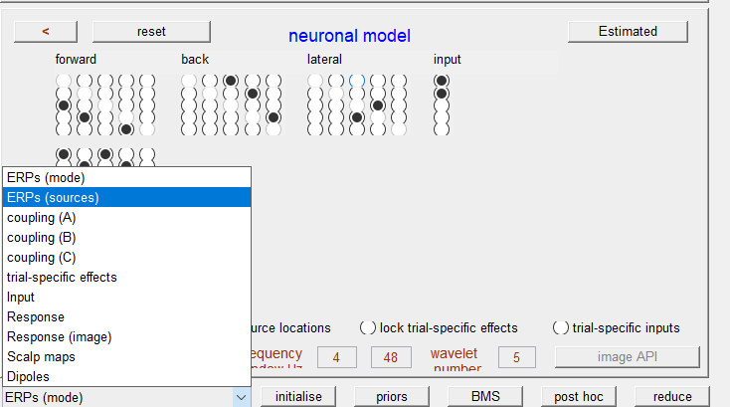
After inversion: check the model fit

Slide 28
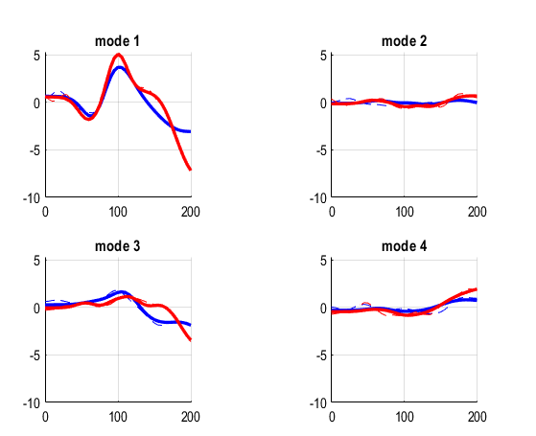
Compare the model output and observed data
Response
ERPs (mode)
What if the prediction is not good?
Check your data (noisy? No significant pattern?)
Check the source locations
Check your model
Notes:
Each line: each channel (128 channels)
Decomposed data into different principle modes (similar to PCA) - combination of multiple channels and timipoints
Add headings
Red vs blue: conditions
Dashed vs solid: observed vs prediction

Slide 29
Step 3: Model selection
Build hypothesis + model
Model fitting
Make an inference
Collect data
Model selection
Adapted from Auksztulewicz (2022), DCM for evoked responses, Presentation, SPM for MEEG course

Slide 30
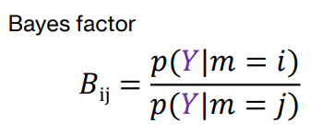
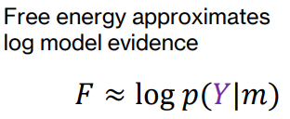
Bayesian model comparison and selection (BMS)
Compare the model evidence of each model
By combining Bayes’ factor and free energy
Copied from Garrido et al., (2007)
BF: interpreted as the evidence of one model over the other. logBF>3 is strong, logBF>5 is very strong
Adapted from Stoof (2022), Bayesian model selection and averaging, Presentation, SPM for MEEG course

Slide 31
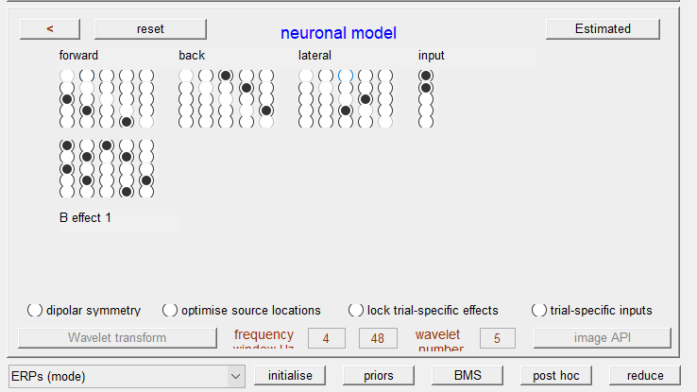
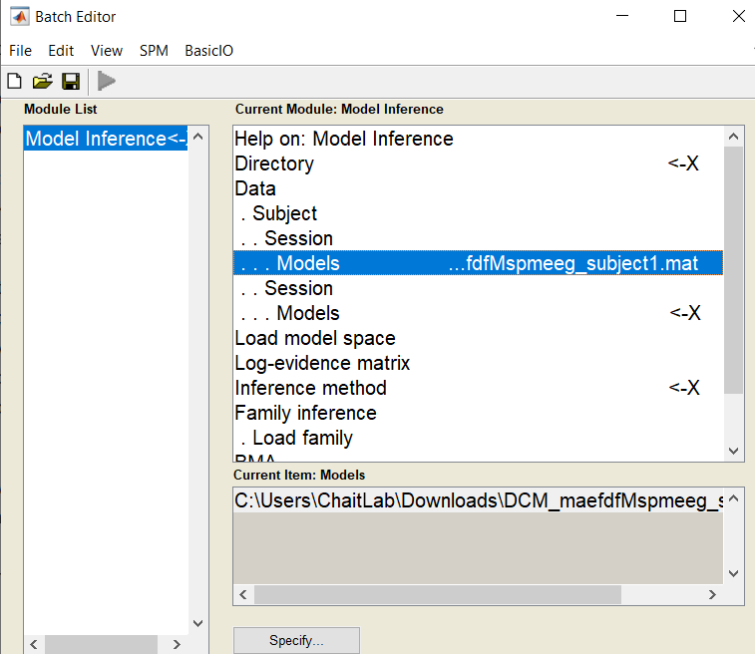
Model selection Demo
Notes:
Directory: dir to save results
For each subject, select all models you want to compare
Method: fixed effects will assume that single subjects have the same underlying winning model; random effects will assume that single subjects can differ with respect to their winning model.

Slide 32
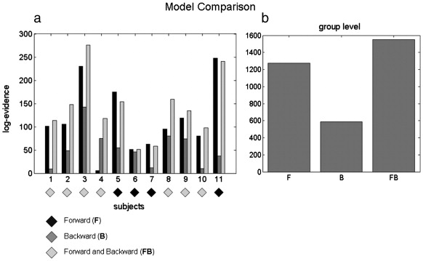
BMS output
Copied from Garrido et al., (2007)
Notes:
Vs null model
Best model for each subject and in a group level
Group level: add individual log evidence

Slide 33
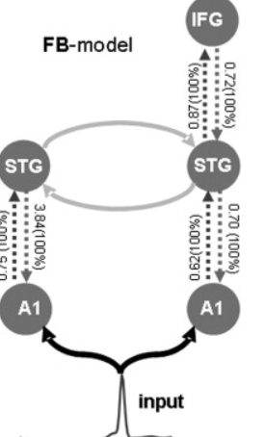
Report your winning model
Two regions vs three regions
Top down, bottom up, or recurrent?
Which connectivity is required?
Which connection is affected by the experimental condition?
Copied from Garrido et al., (2007)

Slide 34
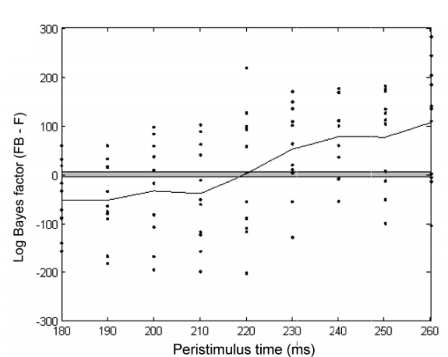
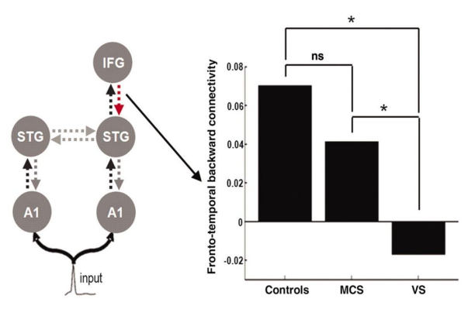
Examples of questions
Boly et al., 2011
Garrido et al., 2007

Slide 35
Summary
Build hypothesis + model
Model fitting
Make an inference
Collect data
Model selection
Adapted from Auksztulewicz (2022), DCM for evoked responses, Presentation, SPM for MEEG course

Slide 36
Other applications of DCM
Copied from van Wijk (2022), The principles of dynamic causal modeling, Presentation, SPM for MEEG course
Notes:
Phenomenological: describes the time-course of a particular data feature/general description of brain activity. not much of biological details
Physiological: uses the knowledge of the anatomy of cortical column, the types of cell populations in that column, and how they are coupled
DCM: inference method infer parameters on different neural data
Neural mass model
Overview of application of DCM

Slide 37
References
Useful resources:
SPM course for EMEG
SPM12 Manual
Scholarpedia: http://www.scholarpedia.org/article/Dynamic_causal_modeling
Generative model/ model types
Model selection and comparisons:
Kiebel et al ., (2006), DCM of evoked responses in EEG/MEG with lead field parametrization
Kiebel et al., (2008), Dynamic causal modeling for EEG and MEG
Garrido et al., (2007), Dynamic causal modeling of evoked potentials: A reproducibility study
Kass and Raftery (1995), Bayes factors

